Slide 1
Wireless Embedded Roadway Health Monitoring System
May 15-23
Members:
Johnnie Weaver, Tyler Fish, Mitch Balke, Brandon Wachtel,
Brandon Maier, Trieu Nguyen, Christofer Sheafe
Advisors:
Dr. Daji Qiao, Dr. Jiming Song, Tie Qui, Jeramie Vens

Slide 2
Problem Statement
Structural health monitoring systems evaluate structures for safety without requiring the presence of an inspector. Implementing such a system without wireless communication becomes too difficult, fragile, and expensive to be feasible. A wireless sensor network makes the system low cost, have quick installation times, and high system reliability.

Slide 3
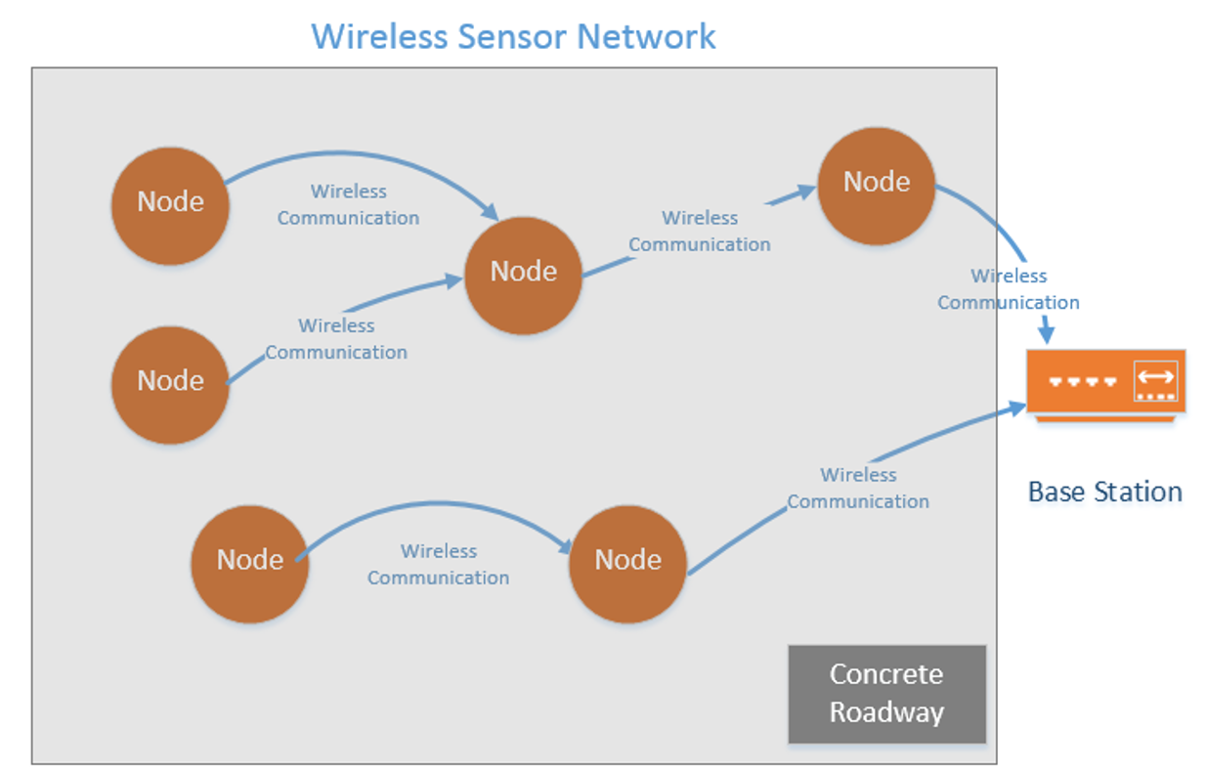
Conceptual Sketch

Slide 4
Member Responsibilities
Brandon Wachtel, Johnnie Weaver, and Trieu Nguyen
  Power Supply and Charging Station
Mitch Balke and Brandon Maier
  Embedded Programing and Network setup
Tyler Fish and Chris Sheafe
  Communication Overhead and RF Charging System

Slide 5
Functional Requirements
Communication
Microcontroller
Sensors
Power System
Base Station

Slide 6
Non-Functional Requirements
Enclosure needs to be resistant to
  Pressure (up to 30PSI)
  Water
  Chemicals
Base Station must have
  Accessibility
  Security
  Data Integrity

Slide 7
Technical Considerations
Attenuation of signal in concrete
Acidity of mixture
Safety of nodes during mixing
Frequency selection ISM

Slide 8
Market Survey
Research on signal transmission through concrete
Research on circuits embedded in concrete
Life-long monitoring of structural integrity
Application in other structures such as bridges and skyscrapers

Slide 9
Potential Risks & Mitigation
EM and RF power transfer
  High power
Burns from soldering parts
Cuts from cutting/dremel tools
Dust in eyes from cutting/dremel tools

Slide 10
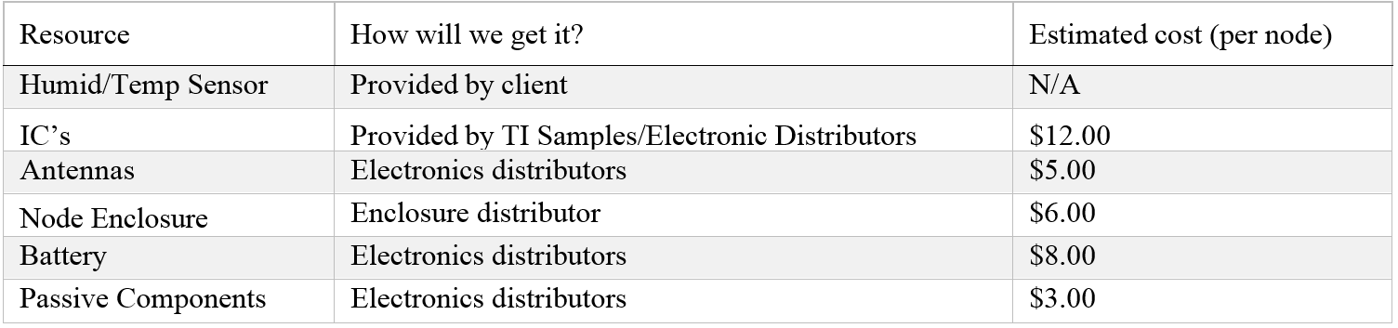
Resource/Cost Estimation

Slide 11
Project Milestones & Schedule

Slide 12
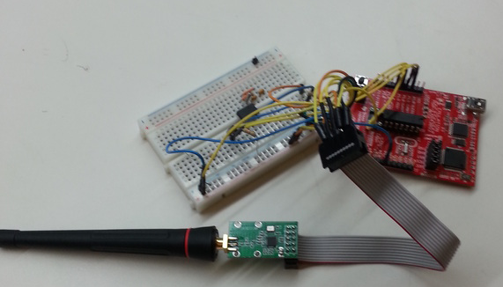
Functional Decomposition
Communication (TI CC1101)
  433 MHz
Microcontroller (MSP430F-series)
  Powerful development platform
  Serial interface
Humidity/Temperature Sensor (SHT71)
    Additional sensors could be added.
RTCC (Microchip MCP79510)
  Accurate timestamps
  Network scheduling
Base Station
  Data extraction
Microcontroller and Antenna Circuit

Slide 13
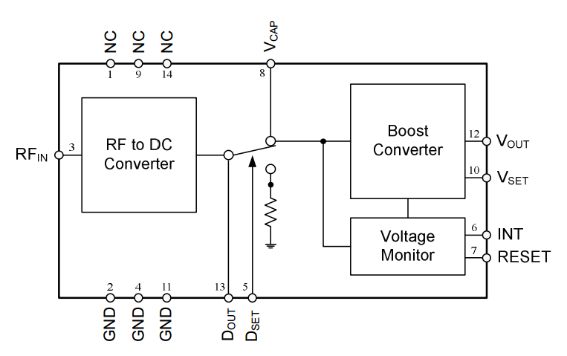
Functional Decomposition
Power System (Inductive Coupler/RF)
  RF - 915 MHz
    RF power harvester receiver (Powercast P2110)
    Patch antenna
  Magnetic Resonance Coupling - 27.2 MHz
    Transmitting coil → Receiving coil
    High frequency AC to DC converter
    Voltage regulator
Functional Block Diagram of P2110
http://www.powercastco.com/PDF/P2110-datasheet.pdf

Slide 14
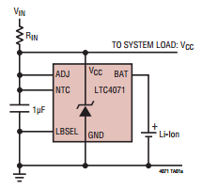
Functional Decomposition
Charging Circuit
  Monitors the current entering the Li-Ion battery
  Protects the battery from over-depletion & high currents
Battery(Ultralife UBP002)
  Will be sized to last a year without charging
  Remaining battery capacity will be chargeable - 12 hrs maximum
LTC 4071 Charging Chip

Slide 15
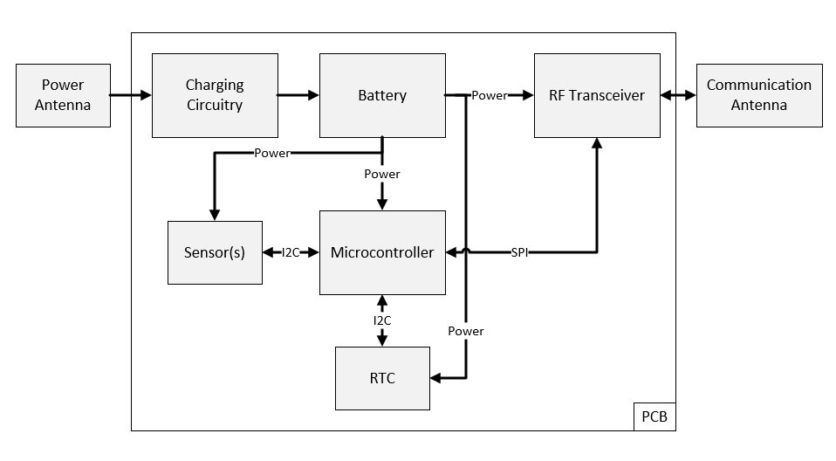
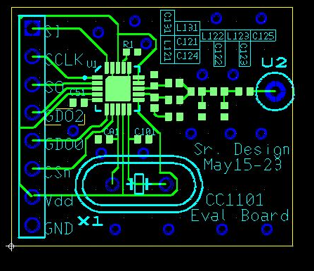
System Overview and MC Design
Transceiver PCB
System block diagram

Slide 16
Test Plan
Communications will be tested in air then concrete
Battery will be charged using conditions found in concrete
Finalized circuit will have current draw measured
Sensor Network
Final Test
  Plant node into setting concrete
  Test its accuracy after curing process.

Slide 17
Current and Planned Prototypes
  The charging circuit has been designed & built
    Still has bugs to be worked out
  The communication circuit has been designed & built
    Currently being tested
  Patch Antennas
    Currently crafted(needs testing)
  Inductive Coils
    Created and requires further tuning

Slide 18
Current Project Status
Software Design
Testing Parts
  One-to-One Node Communication
  Charging Circuit

Slide 19
Plan for Next Semester
January
  Full PCB Design
  Multi-hop communication within the network
Feb
  Begin System Testing
March
  Completed design
  Begin Write-ups and Documents

Slide 20
Questions?

Slide 21
References
[1] Shan Jiang, “Optimum Wireless Power Transmission for Sensors embedded In Concrete,” Ph.D. dissertation, Graduate College, FIU, Miami, FL, 2011.
[2] Jonah, O.; Georgakopoulos, S.V. “Efficient wireless powering of sensors embedded in concrete via magnetic resonance,” Antennas and Propagations (APSURSI), 2011 IEEE International Symposium on , vol., no., pp.1425, 1428, 3-8 July 2011.
[3] Stone, W. C. (1997). Electromagnetic Signal Attenuation in Construction Materials. NIST Construction Automation Program Report No. 3.
[4] Dalke, R.A. (2000). Effects of reinforced concrete structures on RF communications. IEEE Transactions on Electromagnetic Compatibility. 42(4) 489-496.
[5] Taylor, Gutierrez, Langdon, Murphy, Walton (1997) Measurement of RF Propagation into Concrete Structures over the Frequency Range 100 MHZ to 3 GHz. The Springer International Series in Engineering and Computer Science Volume 377. 131-144.
[6] “Antenna Theory.” Internet: http://www.antenna-theory.com/antennas/patches/antenna.php, 2011 [Oct. 18, 2014].

Slide 22
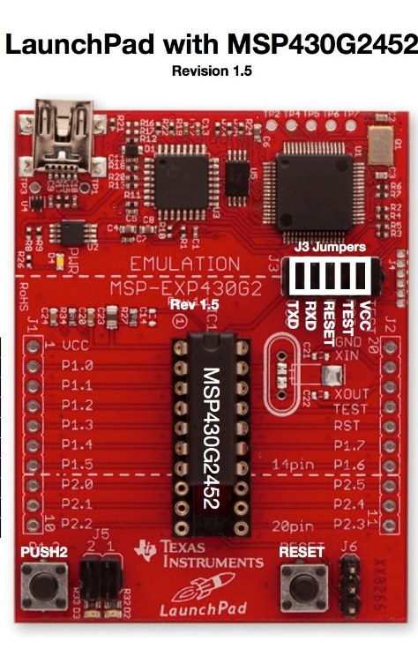

Platforms Used
Software written in C using TI Code Composer Studio
MSP430 programmed on MSP430 Launchpad

