Slide 1
Wireless Embedded Roadway Health Monitoring (WERHM)
Members:
Brandon Wachtel
Johnnie Weaver
Trieu Nguyen
Chris Sheafe
Brandon Maier
Mitch Balke
Tyler Fish
Advisers:
Dr. Daji Qiao
Dr. Jiming Song
Dr. Tie Qiu
Jeramie Vens
Client:
Dr. Halil Ceylan,
Department of Civil, Construction and Environmental Engineering

Slide 2
Scope of the Project
What are we doing?
Why are we doing it?
Past efforts

Slide 3
Scope - What are we doing?
Creating a network of nodes that measure humidity and temperature within roadways
Requirements of the network are:
Wireless communication between nodes and a base station that stores data
Low power consumption for extended life
Able to withstand harsh environment- temperature, chemicals, stress, etc.
Node size must be small enough to minimize impact on road integrity.

Slide 4
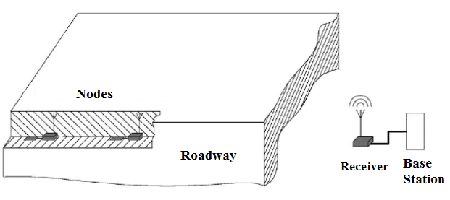
Scope - Why are we doing it?
Provides a feasible method of monitoring the status of roadways and other structures throughout their lives
Directly observes the condition of the roadway at different parts as often as desired
Determines more accurately when a roadway needs to be replaced
Wireless Communication

Slide 5
Scope - Past Efforts
Wired Communication
Delicate-Connections destroyed during pouring and curing process of concrete
Wireless Communication using Zigbee operating at 2.4GHz
High power consumption- surviving nodes died within a few days

Slide 6
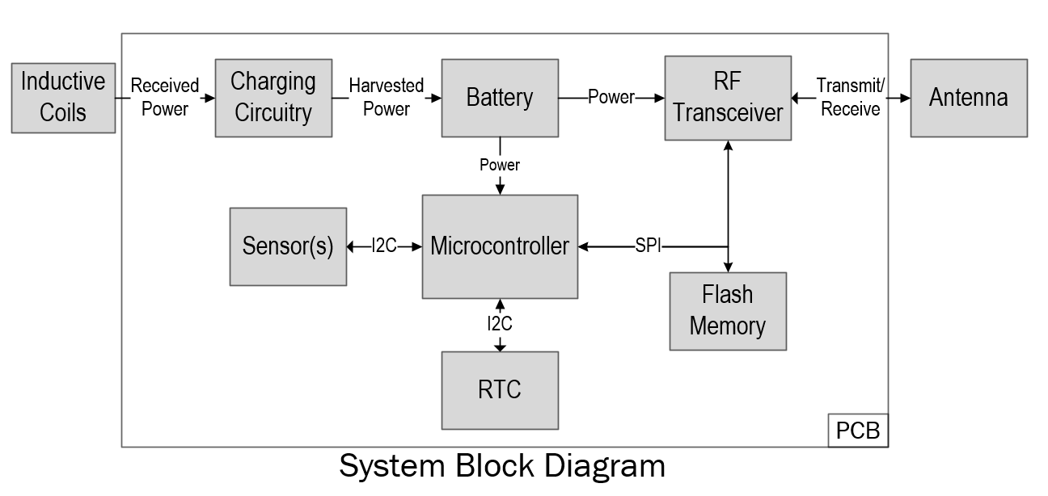
Current Design
Software/Networking
Hardware
Power Transfer
Charging
Battery
Enclosure
Base station

Slide 7
Current Design - Software/Networking
Wireless Sensor Network utilizes directed flooding technique
All software optimized for low power consumption, very low active duty cycle

Slide 8
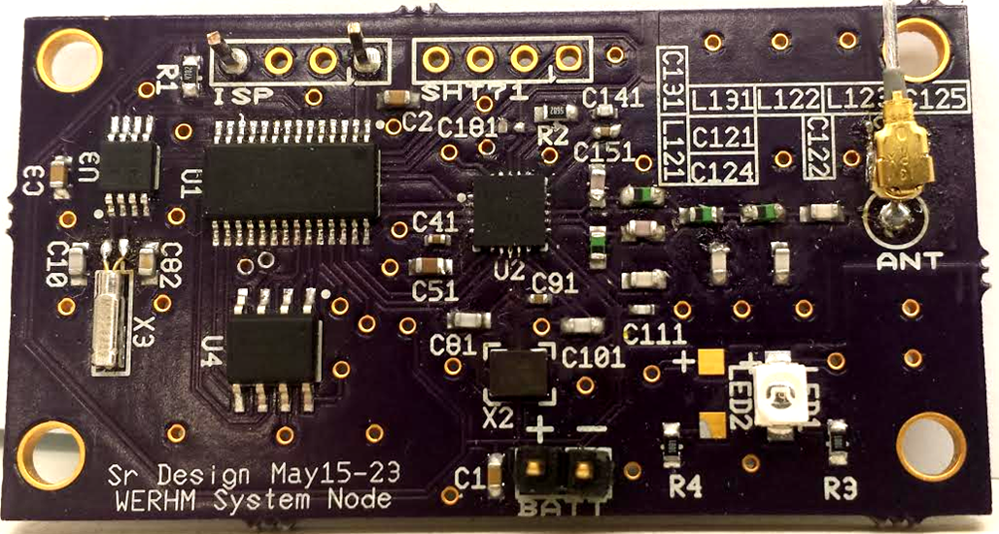
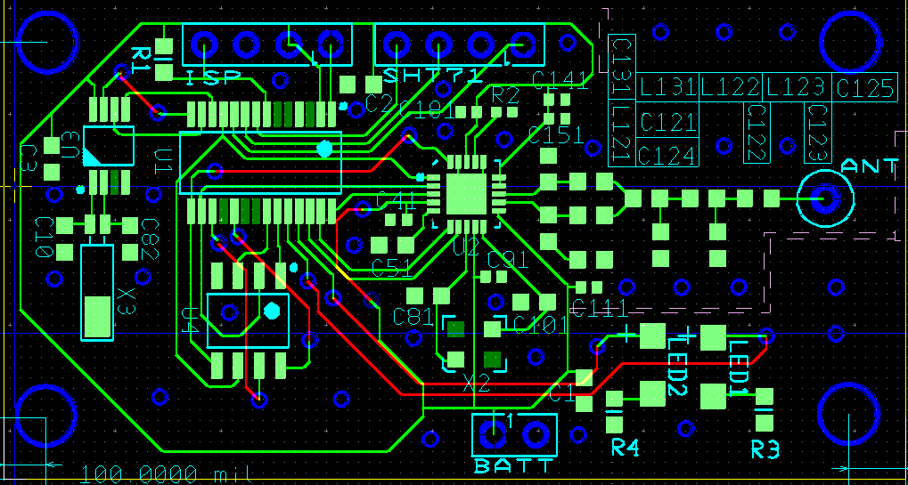
Current Design- Hardware
Powered by MSP430F2122 MCU
4 Mbit serial flash storage
RTCC for accurate timekeeping
Overall size 1 1/8” x 2 1/8"
Alternate design includes battery charging circuitry
Non-Charging PCB

Slide 9
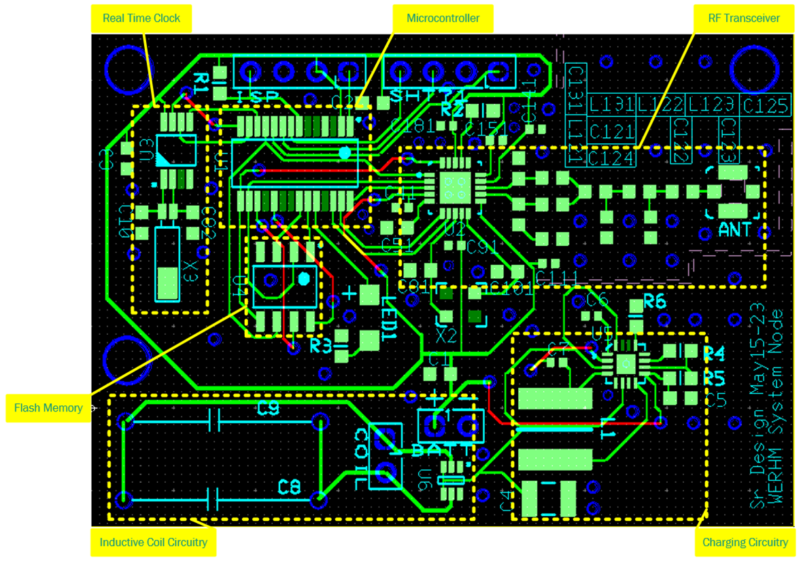
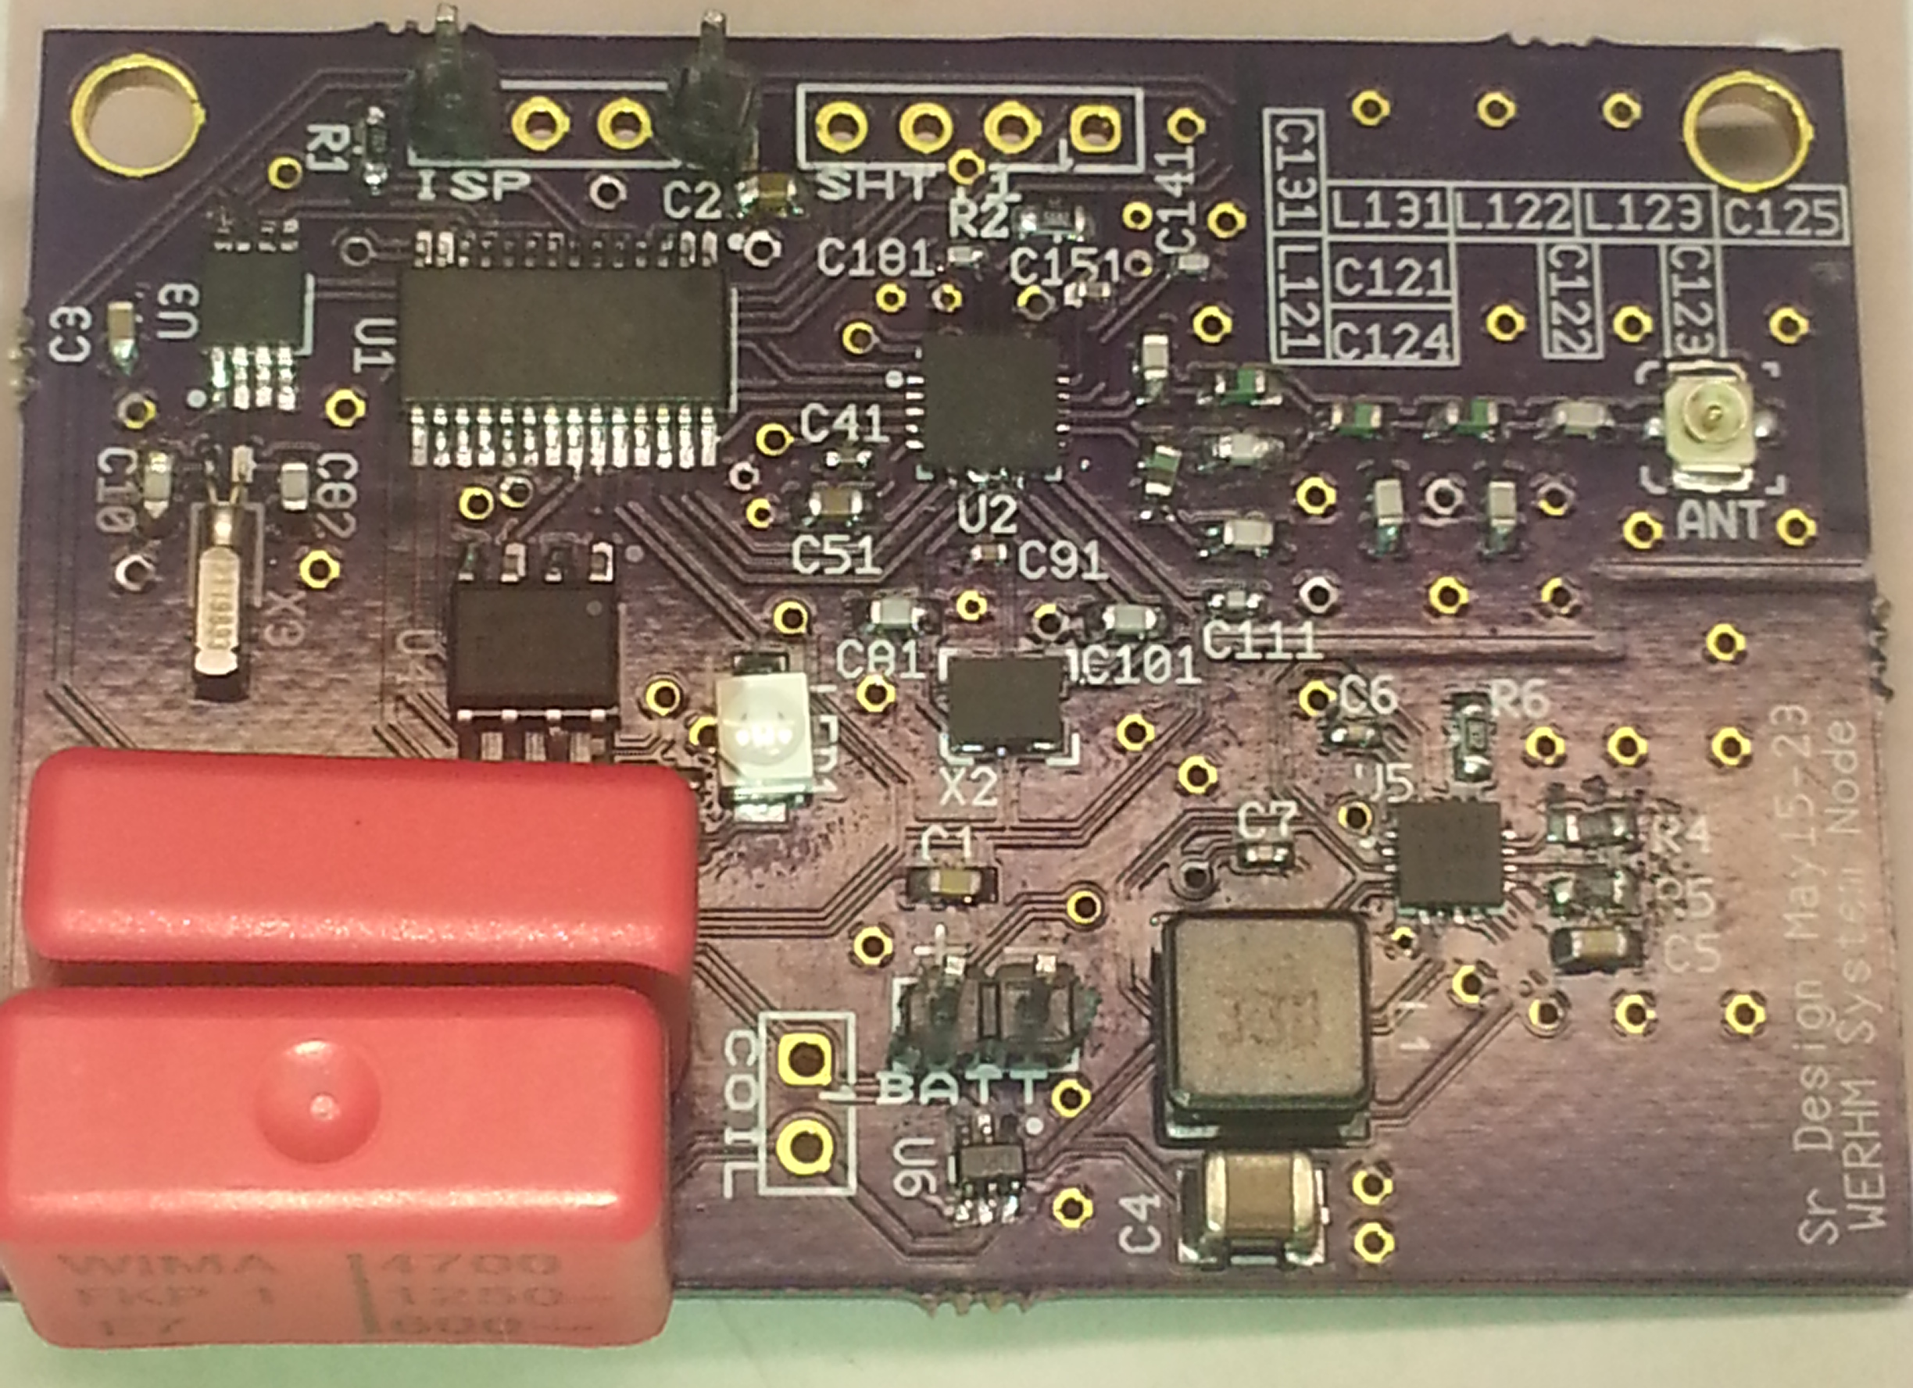
Current Design - Hardware
PCB w/Charging

Slide 10
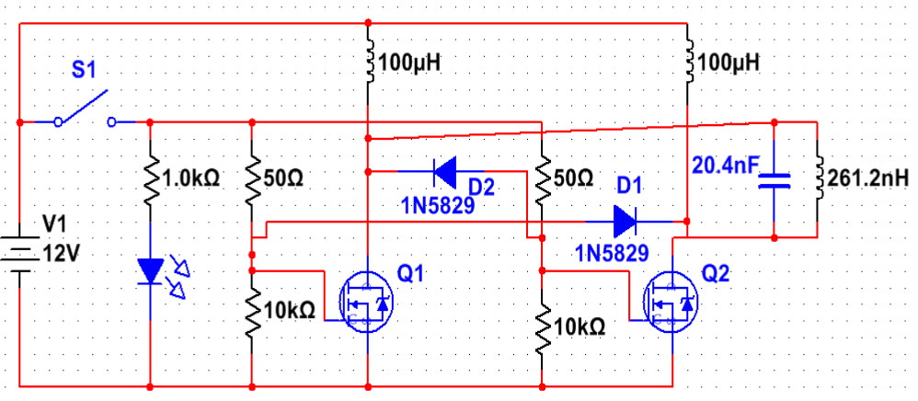
Current Design - Power Transmission
Power transmitter
Based on Royer Oscillator circuit with 12 VDC power supply
Transmission frequency depends on LC tank of the circuit
Current resonant frequency is 2.189 MHz

Slide 11
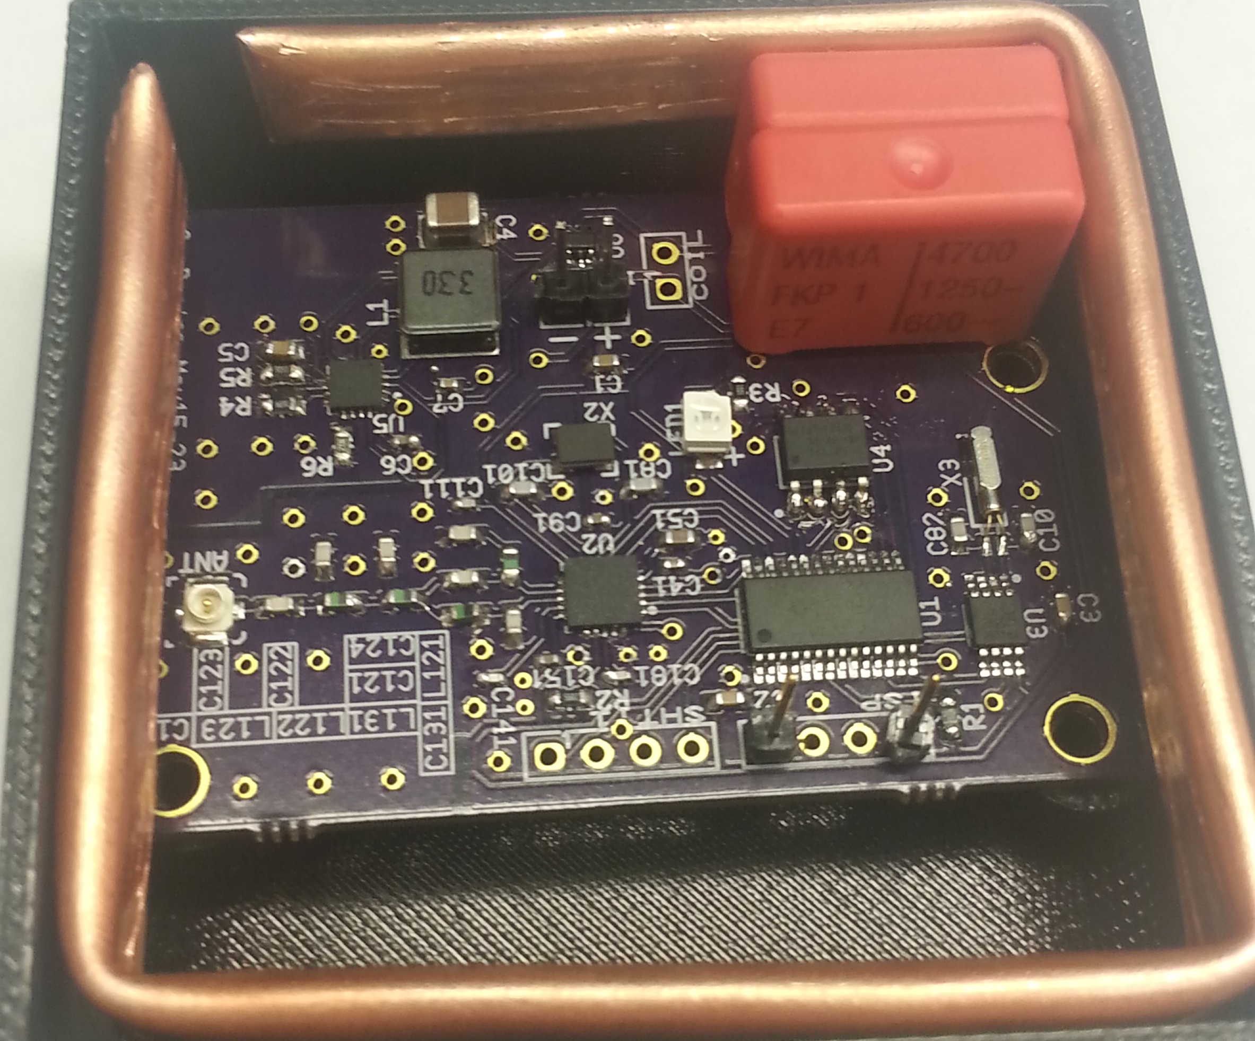
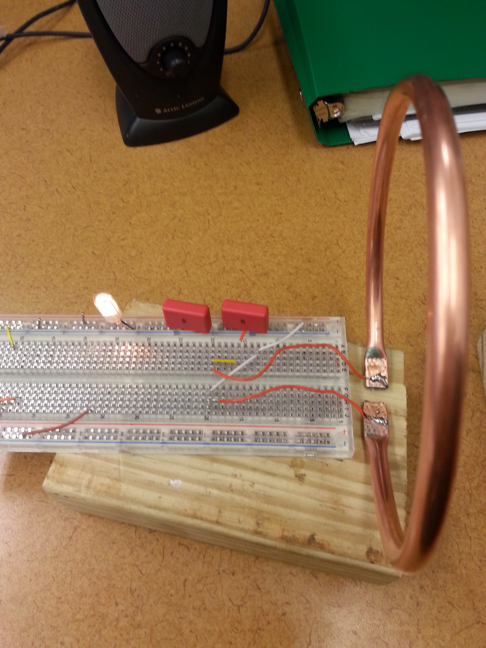
Current Design –Power Receiver
Single 2-in square coil
Frequency matching by adding capacitor(s).
Best efficiency

Slide 12
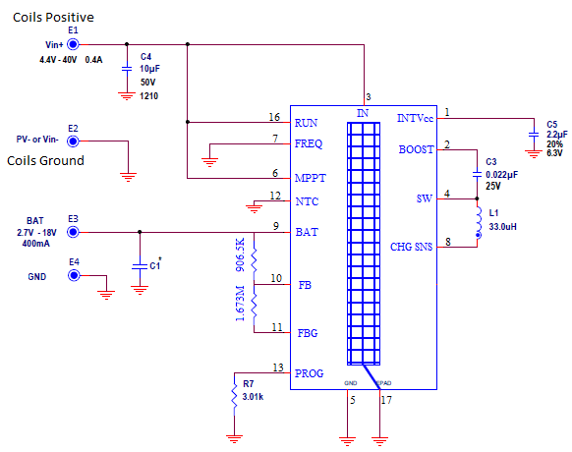
Current Design - Charging
The charging circuit shall be based around Linear Technologies LTC4121.
The input is 4.2V – 40V and 400mA.
This chip was chosen based upon a phone conference with a LTC representative
The chip can be found here. http://www.linear.com/product/LTC4121

Slide 13
Current Design – Battery
900 mAH Lithium-Ion Rechargeable Battery
$$\frac{Battery mAH}{Consumption in mA}∗.7=Battery life in hours$$
$$\frac{BatteryLife}{24H}=Battery Days$$
$$\frac{BatteryDays}{365D} = Battery life in years.$$
$$\frac{900mAH}{.00998mA}∗.7=63113.53 hours$$
$\frac{63113.53H}{24H}$ = 2629.73 Days
$\frac{\text{2629.73 }\text{D}}{365D}$ = 7.20 Years
Equation based from Digikey.com

Slide 14
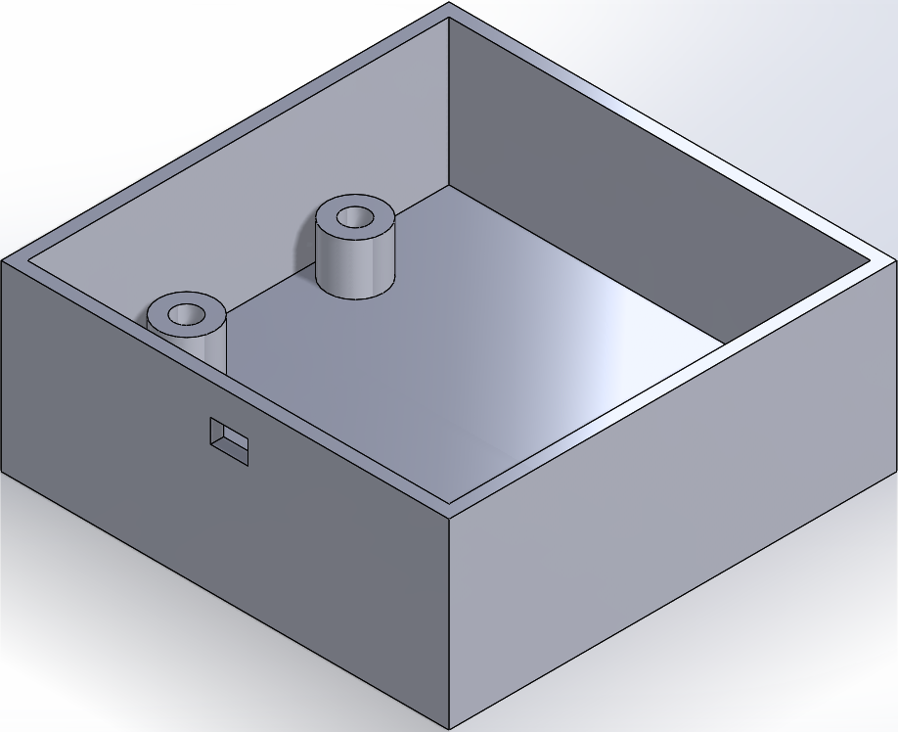
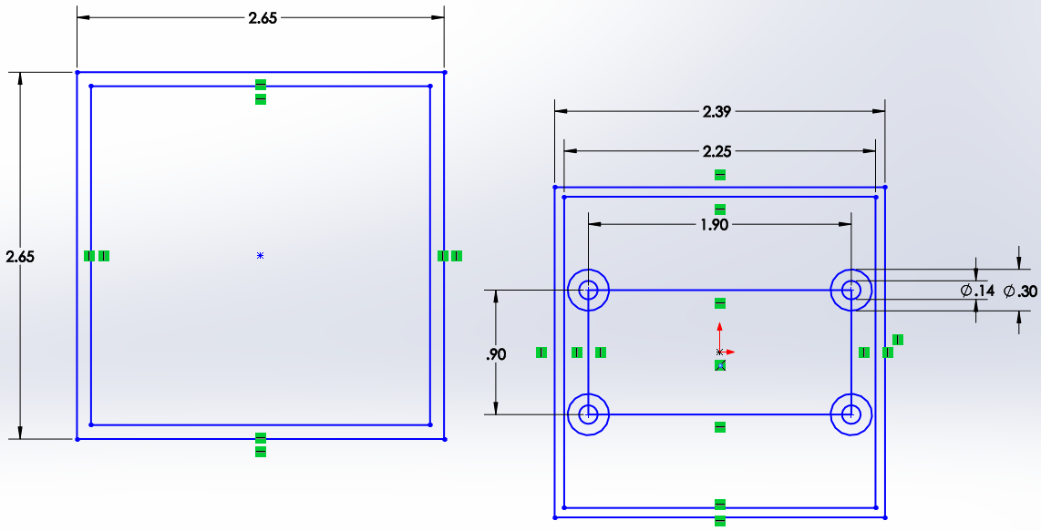
Current Design - Enclosure
Two enclosure designs
3-D printed using ABS plastic
Acrylonitrile Butadiene Styrene
Needs to withstand the heat, pressure, and acidity of curing concrete

Slide 15
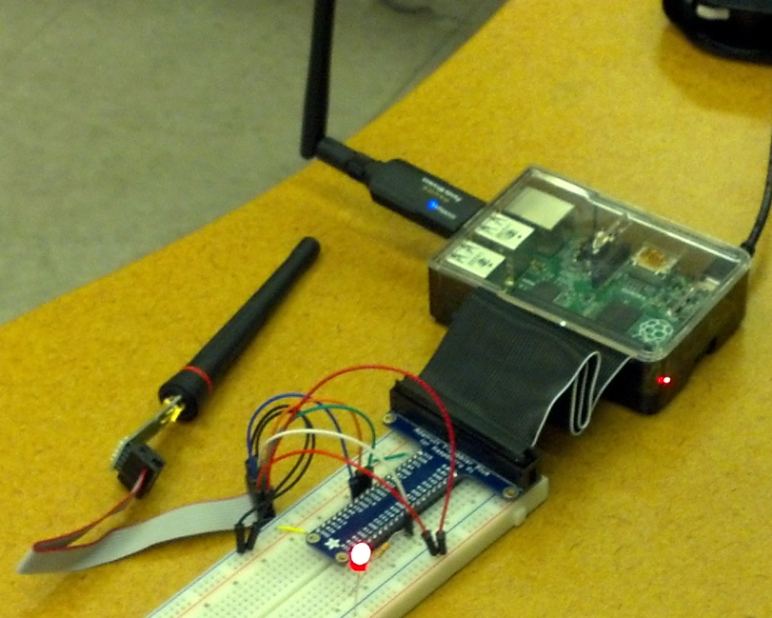
Current Design - Base station
Base Station is the system’s access point
Collect readings from network
Configure run-time settings
Starts network setup and configuration
General-purpose computer with transceiver
Adaptable to different use-cases
RaspberryPi B+ with a CC1101

Slide 16
Challenges
Wireless Charging
Network Routing
Miscellaneous

Slide 17
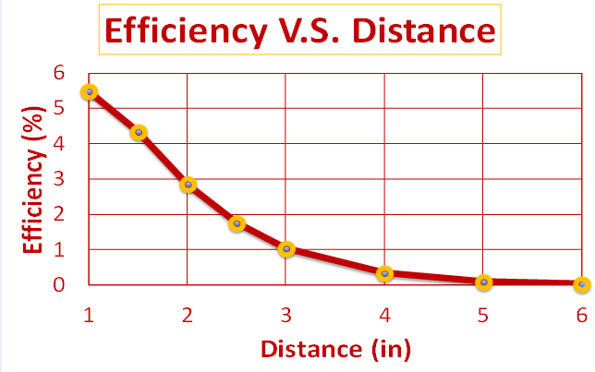
Challenges - Charging
Charging through concrete
Charging range
Up to 8 inches
Efficiency rapidly decreases
Size of the coils
Approx. 2” square
results in a very small amount of magnetic flux

Slide 18
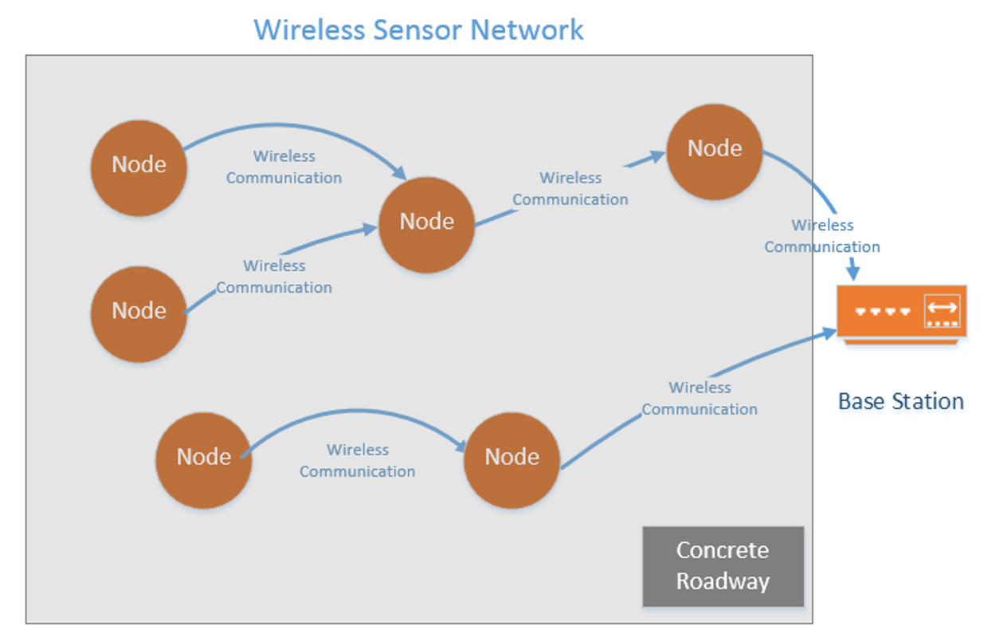
Challenges - Network Routing
Wireless ad hoc network
Network decentralized and topology unknown
Custom version of flooding
Nodes broadcast packet in direction of Base station
Simple, but not optimal
Network must survive failing nodes

Slide 19
Challenges - Miscellaneous
Size constraints require reflow assembly
Lack of experience
Sensor Exposure
Expose the sensor indirectly to the concrete environment
Temperature
Exposure to Iowa summer/winter temperatures
Ranging from -20 F to 140 F

Slide 20
Test Plan
Network Routing & Communication
Power Transmission
Charging Battery
Enclosure

Slide 21
Test Plan - Network Routing/Communcation
Test data integrity in multi-hop network
In and out of concrete
Test network resilience to node failures
Texas Instruments CC1101 RF Transceiver
433 MHZ frequency selected for propagation through concrete

Slide 22
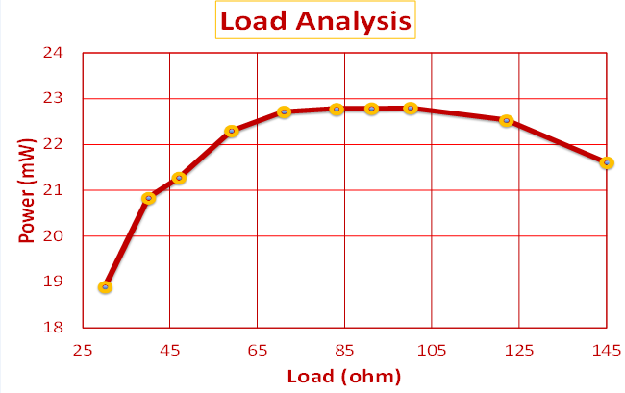
Test Plan - Power Transmission
Test circuit through air then concrete
Measure efficiency and compare
Load Analysis
100 Ohms ideal for maximum efficiency
Efficiency based off power input vs output

Slide 23
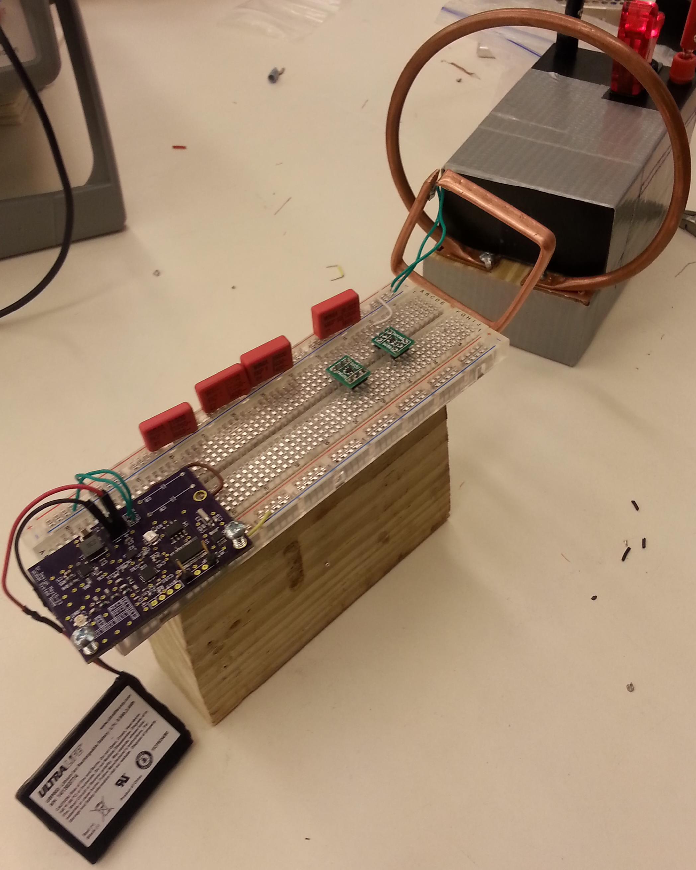
Test Plan - Charging Battery
Testing of the charging circuit will be in two steps.
Charging with a Benchtop DC power supply as the source.
Charging with inductive coils as the source.
For both tests, a NI MYDAC will capture the charging curve.
Wireless Charging

Slide 24
Test Plan - Enclosure
Waterproof Test
Submerge enclosure in water
Remove from water and checked for moisture in enclosure
Weight Test
Used a flat surface to distribute weight
Place weights on each side
Nylon Mesh Covering
Sensor Retrieved After Burial

Slide 25
Scenarios we Thought / Accounted For
Temperature Ranges
Loss of Power (Battery Dies)

Slide 26
Scenarios - Temperature Ranges
LI-ION battery Operating Temperatures
Charging Range: 32 ⁰F to 113 ⁰F
Discharging Range: -20 ⁰F to 140 ⁰F
No charging below freezing.
Better efficiencies at higher temperatures.
http://batteryuniversity.com/learn/article/charging_at_high_and_low_temperatures
All other components fall roughly within the LI-ION’s operating temperature range.

Slide 27
Scenarios - Loss of Power (Battery Dies)
If the Battery dies (Falls below 1.2V)
Shutdown mode of charging chip (LTC 4121)
Disconnect the battery from the circuit.
Prevents battery damage
Upon recharge chip will reconnect the battery
Battery disconnect does not delete stored data
The node ID and system time will be retained

Slide 28
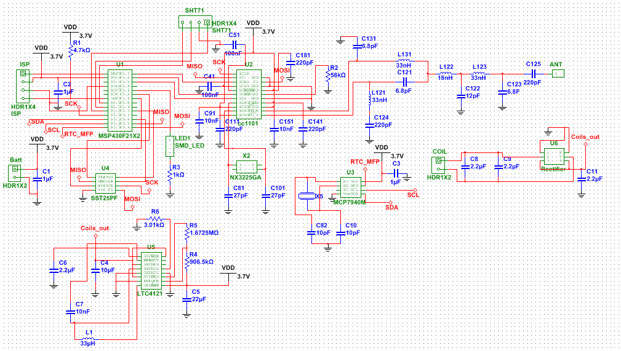
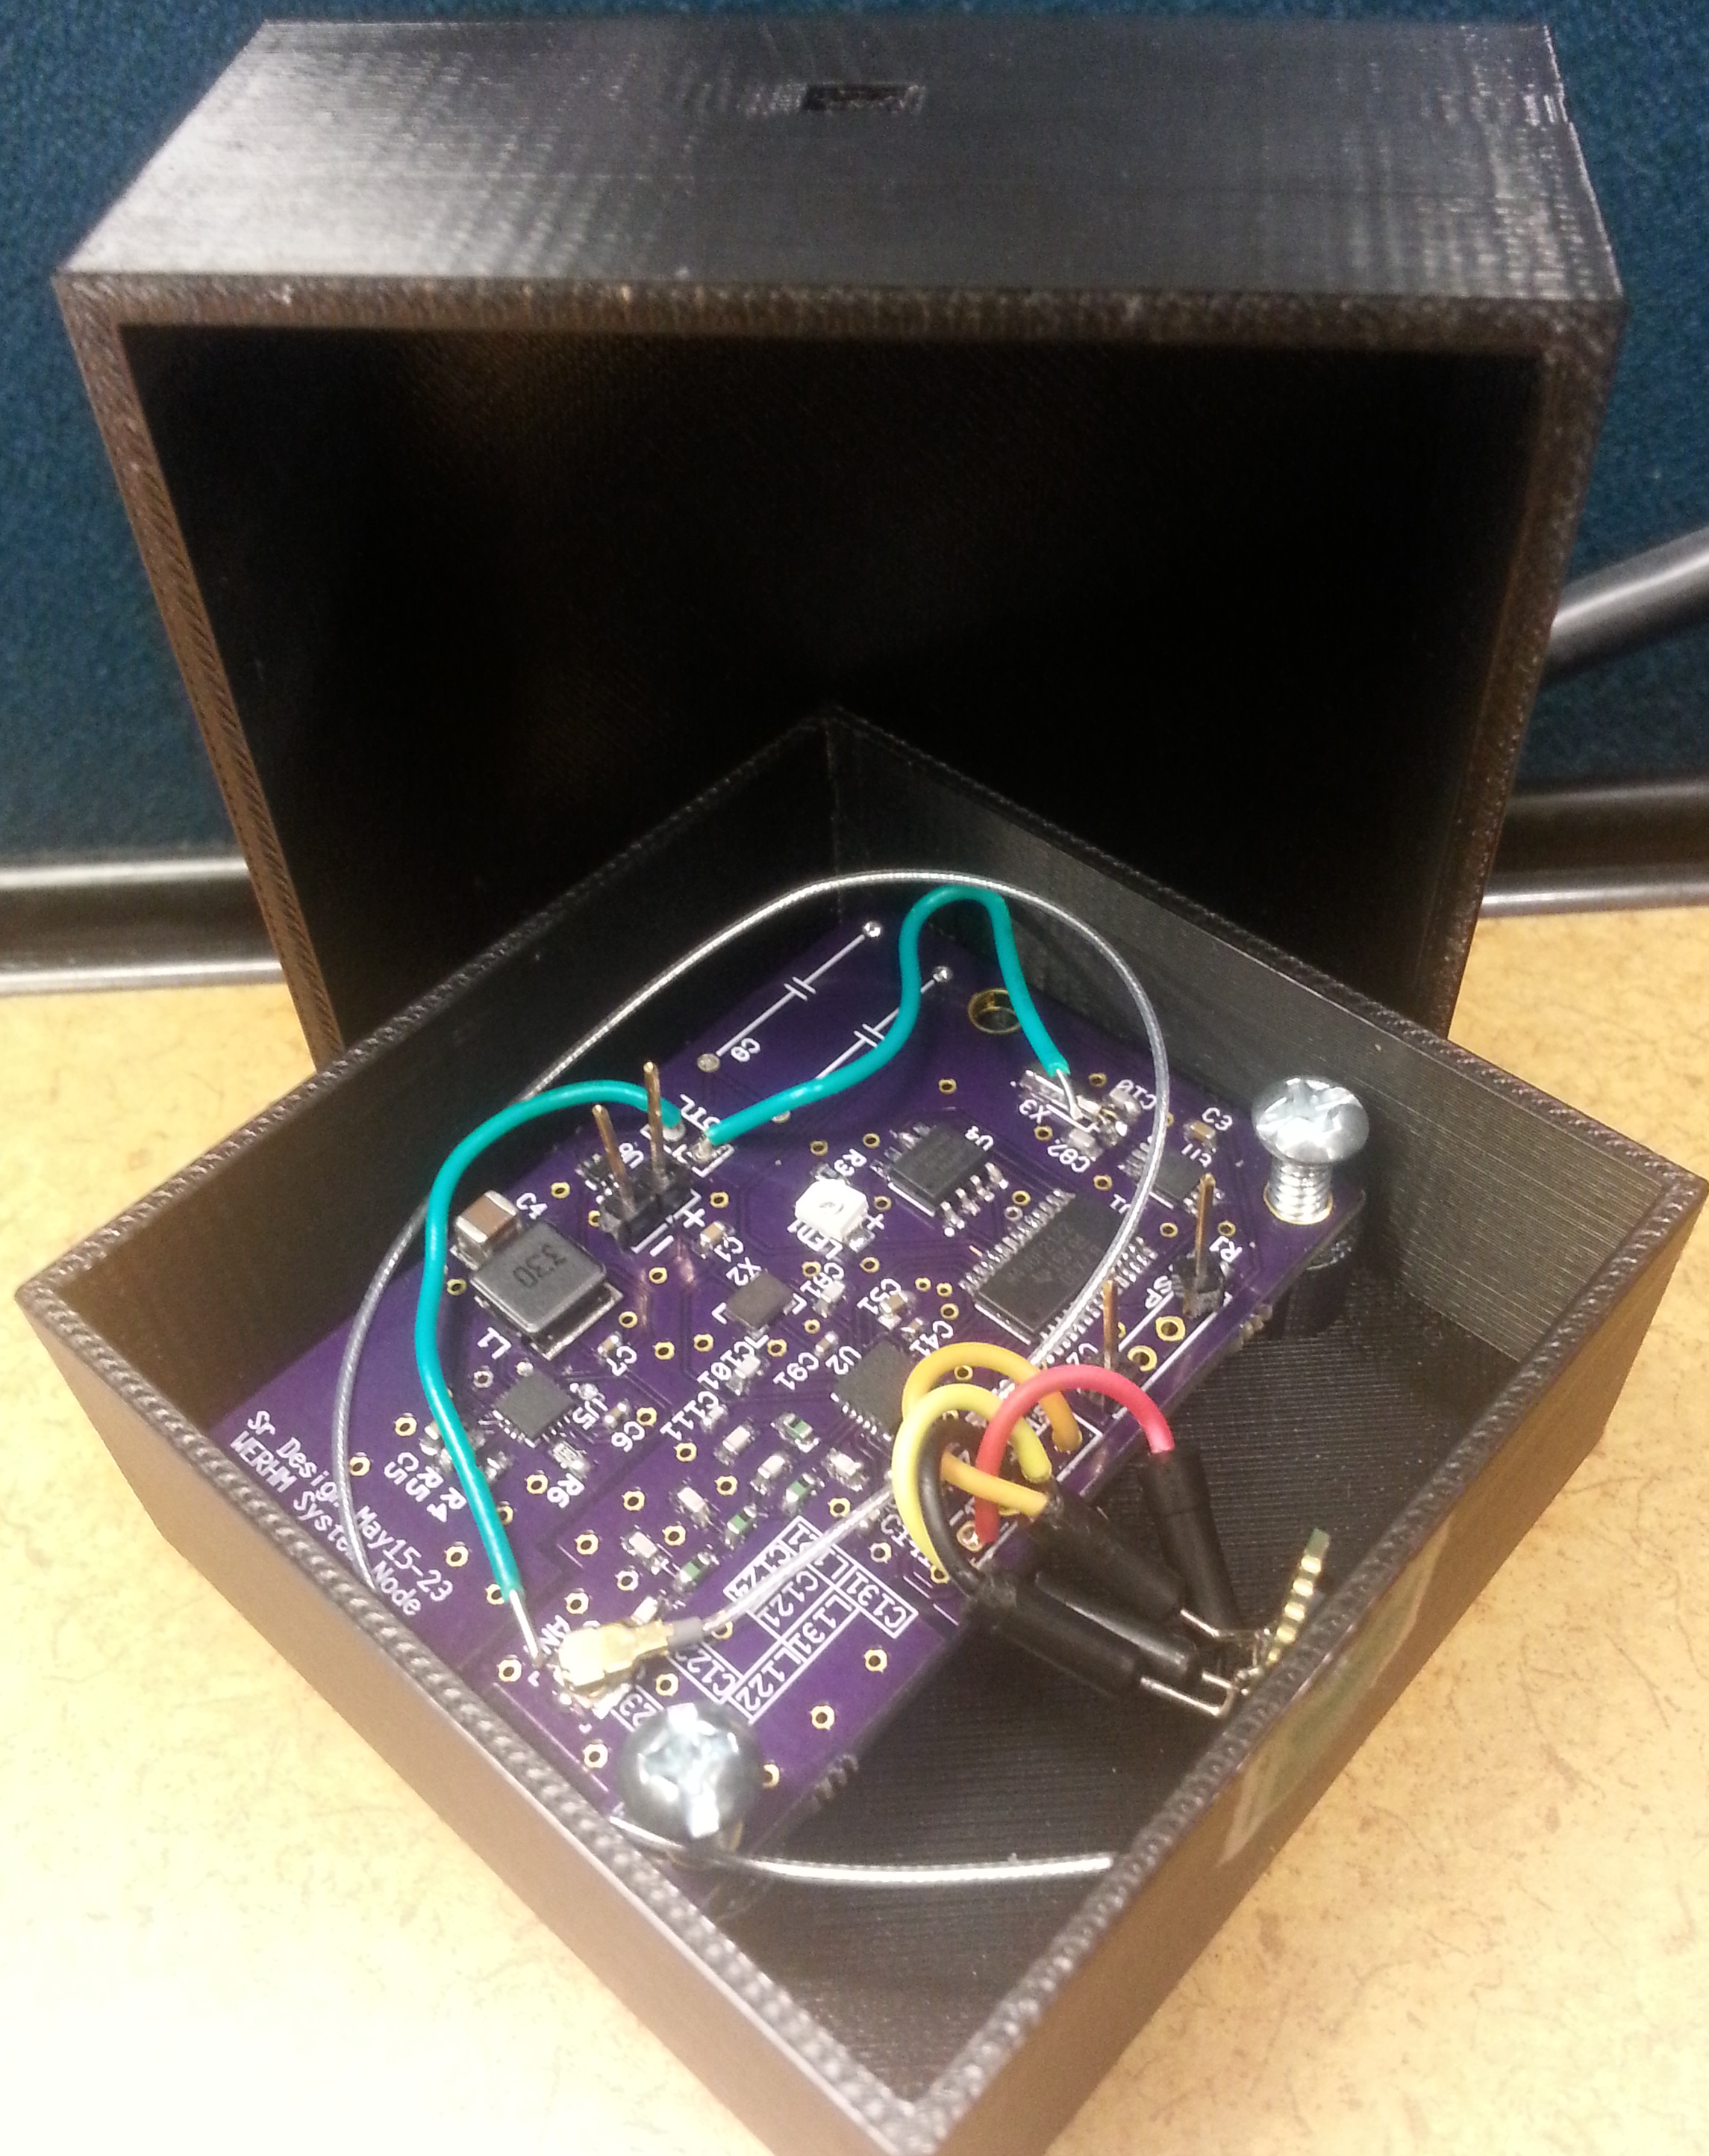
Questions?
Thank You
Sensor Retrieved After Burial
Wireless Communication

